Slide 1

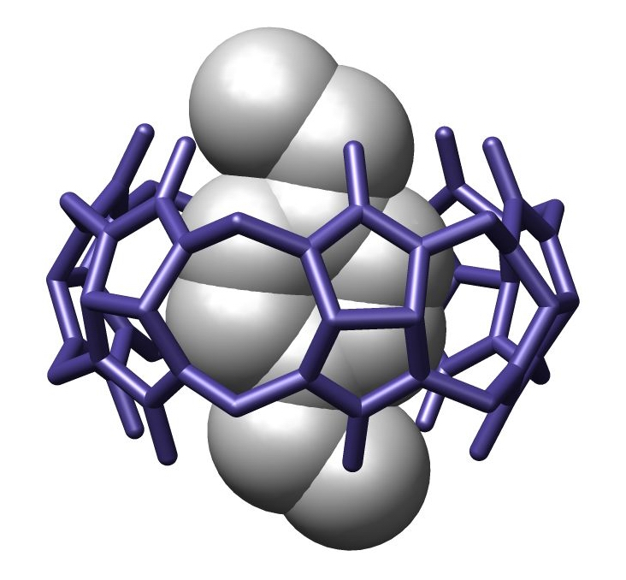
Molecular encapsulation
Τριποδιανός Ελευθέριος
Υπερμοριακή Χημεία

Slide 2
What is molecular encapsulation?
Molecular encapsulation describes the confinement of a guest molecule inside the cavity of a supramolecular host molecule
Molecular recognition
Solvent’s role
If the capsule components are covalently bound however, the time the guest remains inside varies..
Capsule components mainly bear complementary functional groups, which are involved in molecular recognition.
Two types of ‘‘weak bonds’’-non covalent, reversible interactions between complementary functional groups: hydrogen bonds and metal to ligand interactions.

Slide 3
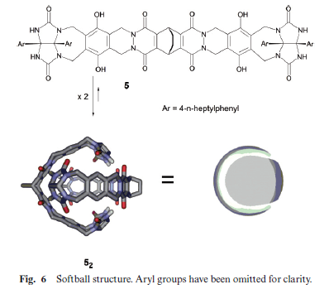
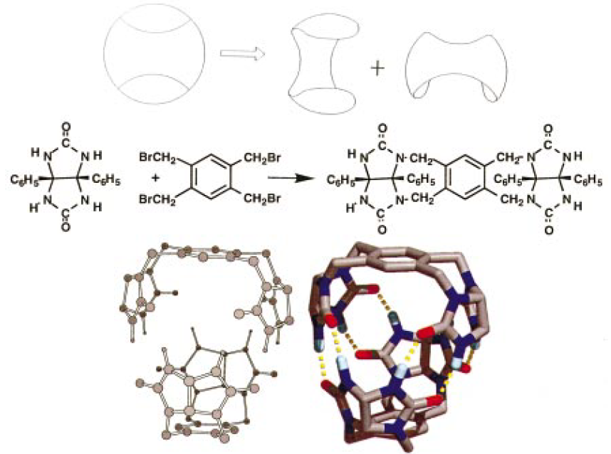
Types of host molecule
There is a big variety in shapes for a host molecule
Glycoluril units provide curvature and a
self-complementary hydrogen-bonding motif.
The tennis structure
The Softball structure

Slide 4
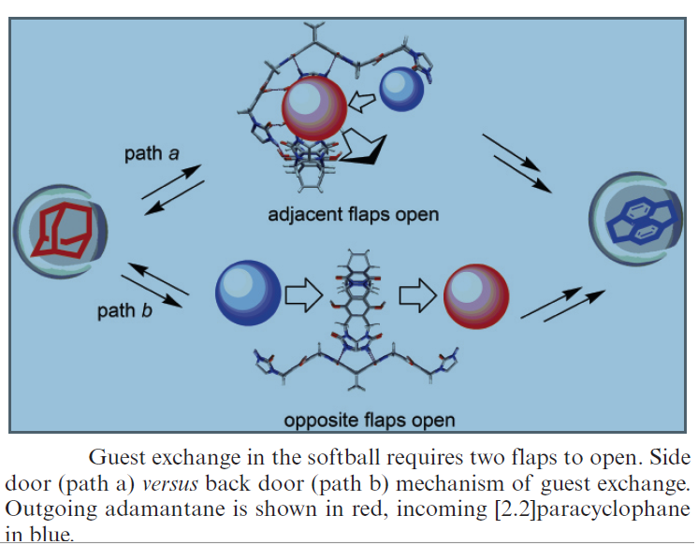
Types of host molecule
The opening of the first flap requires
breaking six hydrogen bonds at a cost
of about 22 kcal mol⁻¹
The side door mechanism appears
more likely since it requires breaking
fewer hydrogen bonds than the latter
mechanism.

Slide 5
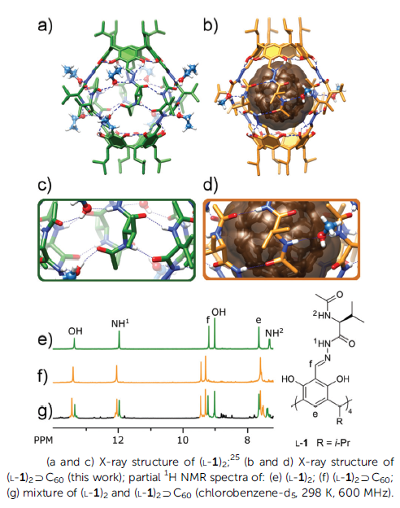
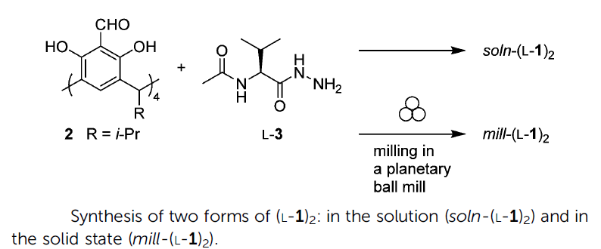
Types of host molecule
Molecular changes during mechanical treatment of
synthetic peptide-based capsules can lead to an
increase of their penetrability, this process is used
for the formation of encapsulation complexes
Encapsulation of C₆₀ occurred:
1. During the chemical reaction of the
synthesis of capsules in a chlorobenzene solution or
2. Upon milling of solid fullerenes with solid capsule soln-(L-1)₂
CB
Szymanski M., Jedrzejewska H., Wierzbicki M., Phys. Chem. Chem. Phys., 2017,19, 15676-15680

Slide 6
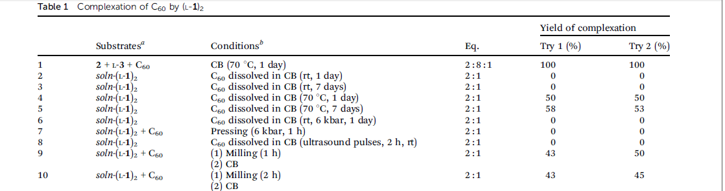
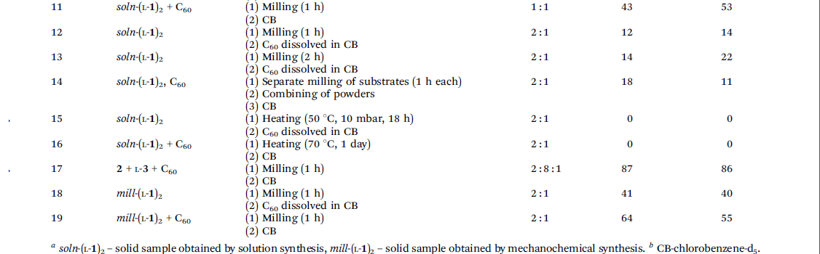
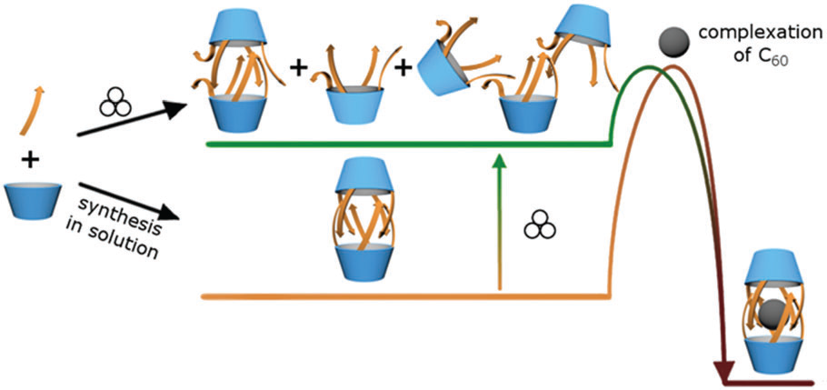
Close contact between particles at this stage (as in the case of milling two components together) increases the local concentration of guest molecules and favors encapsulation.

Slide 7
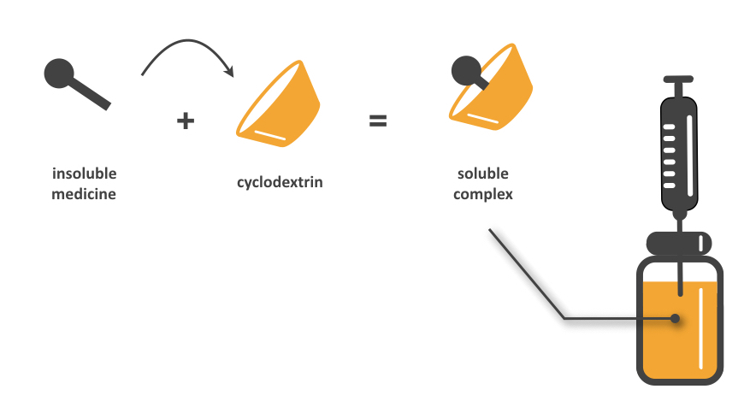
Applications
Isolation of unstable compounds
Controlled reactions
Drug delivery
Adsorption of liquids to solid state

Slide 8
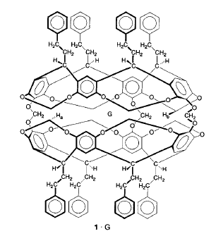
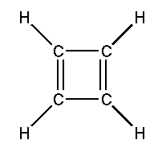
Encapsulation of cyclobutadiene
One host molecule provides one discrete molecular inner phase.
Hemicarcerand 1 allows guest entry and exit at temperatures above 100°C
Inside the 1.(CH)₄, the shell of the host protects the guest (CH)₄ from dimerization, and from reactants too large to pass through the portal of 1 → 1.(CH)₄ stable at ordinary temperatures.
The synthesis and reactions of (CH)₄,are
the first that have been carried out in the confined inner phase of a hemicarcerand
Cram, D. J.; Tanner, M. E.; Thomas, R., Angewandte,1991, 30,, 1024 - 1027

Slide 9
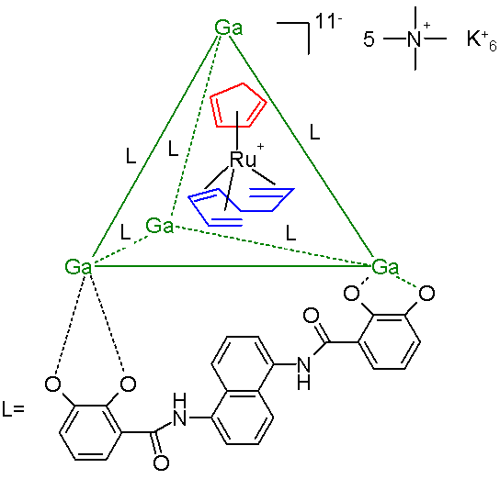
Encapsulation of ruthenium metallocene
Stabilization of reactive
organometallic intermediates
in aqueous solution through
molecular encapsulation.
The metal atoms are located on the vertices of the tetrahedron and the six bis(bidentate) catechol amide ligands span the edges
Encapsulation by a supramolecular host can stabilize certain intermediates,
but stabilization may also be exploited to
alter the chemical reactivity and selectivity of the
bound guest molecules.
Guest: [CpRu(cis-1,3,7-octatriene)]
The ruthenium compound decomposes in water within minutes and in organic solutions within hours but encapsulated it survives in water for weeks.
M₄L₆ tetrahedral assembly constructed from metal and ligand components.

Slide 10
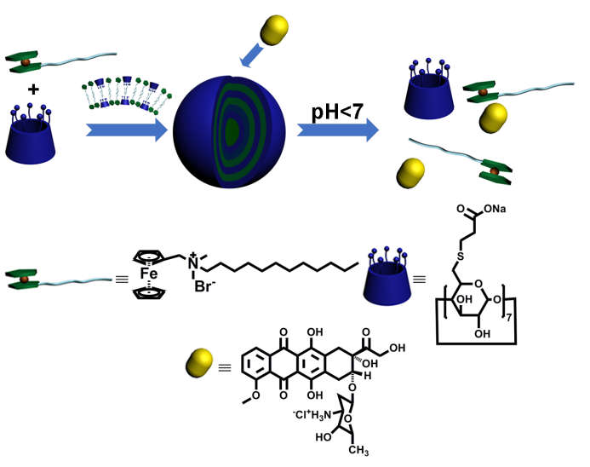
Cyclodextrines controlled drug delivery
Cyclodextrines exhibit:
good water-solubility
well-defined molecular structures
high biocompatibility
low-price commercial availability
accessible chemical modification.
pH-responsive nanoparticle through the noncovalent complexation between
per-6-thiolated β-cyclodextrin sodium salt (SACD) and amphiphilic ferrocene derivative (FC12⁺Br–) in water.
Doxorubicin hydrochloride (DOX) was chosen as the model drug molecule

Slide 11
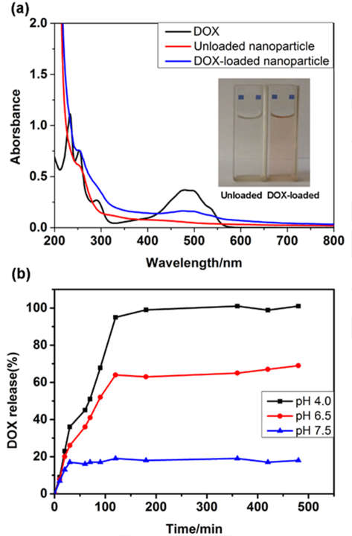
pH responsive assembly.
The drug-loaded assembly was highly stable at room temperature in aqueous medium under neutral condition
The release rate was significantly enhanced when the solution was adjusted to pH 4.0 and 6.5, mainly due to the protonation of
carboxylic sites in the host compound.
These rapid drug release behaviors
showed a good response toward the change of pH values, thus making DOX-loaded nanoparticles a promising candidate
for efficient drug delivery.

Slide 12
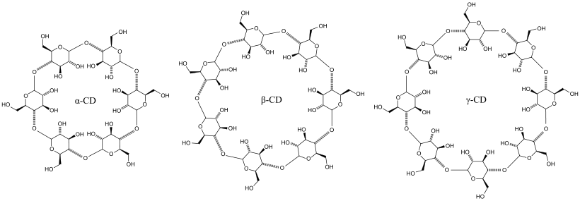
Adsorption of liquids to solid state
Most powdered forms of liquids rely on cyclodextrines to carry "guest" molecules in their inner cavities.
Encapsuled in small capsules the fluid can be handled as a powder
The cyclodextrines can absorb tops 60 percent of their own weight in alcohol, depending on size, shape, number of sugars and how dry it was to start.

Slide 13
Summary
Supermolecular architechtures that are usually driven by intermolecular interactions
Good for isolating unstable compounds
Loading in capsules and release of molecules through responsive stimuli, i.g., drugs
The release and mechanism of the encapsulation guest must be studied further

Slide 14
References
Fiedler, D., Bergman, R. G., & Raymond, K. N. (2006). Stabilization of Reactive Organometallic Intermediates Inside a Self-Assembled Nanoscale Host, 745–748.
Hof, F., Craig, S. L., Nuckolls, C., & Rebek, J. Molecular Encapsulation, Angew. Chem. Int. Ed. 2002, 41, 1488 -1508
Palmer, L. C., & Rebek, J. (2004). The ins and outs of molecular encapsulation, 3051–3059.
Cheng J.,Zhang Y., Liu Y. (2018) Supramolecular Assembly of Thiolated Cyclodextrin and Ferrocene Derivative for Controlled Drug Delivery
Rebek J., Acc. Chem. Res. 1999, 32, 278-286
Szymanski M., Jedrzejewska H., Wierzbicki M., Phys. Chem. Chem. Phys., 2017,19, 15676-15680
Cram, D. J.; Tanner, M. E.; Thomas, R., Angewandte,1991, 30,, 1024 - 1027

Slide 15

Thank you for your attention!!

